Slide 1
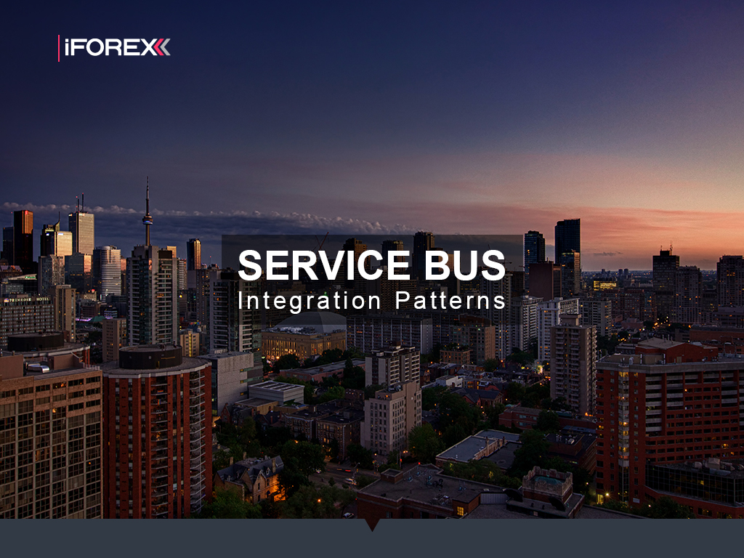
Alex Michel
iFOREX
Silviu Eigel
NESS

Slide 2
Solution
Code
Mass Transit
ESB Concepts
Patterns
Transports
Scale-Out
Mass Transit Stack
Legacy System
Design
Problems
Integrations
Architecture

